Slide 1
Sensor Array
List of proposed sensors

Slide 2
Parameters Measured
Temperature
Pressure
Humidity
Light Level
Precipitation Level
Wind Speed

Slide 3
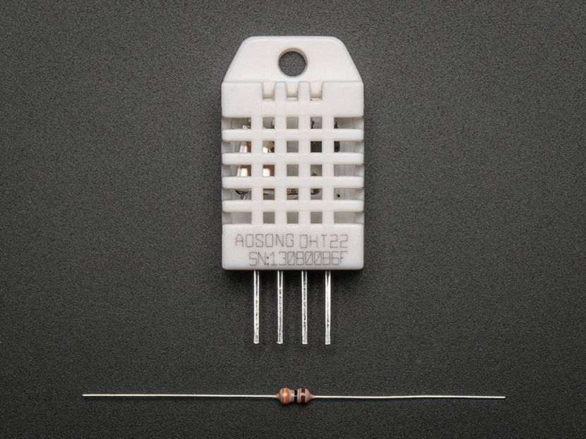
Temp and Humidity Sensor
DHT22
Measures:
Temperature
Humidity
Price: $9.95
Pros:
±0.5°C Accuracy
Long Range
Smooth Curve
Cons:
Can only provide data every 2 secs
Really sensitive

Slide 4
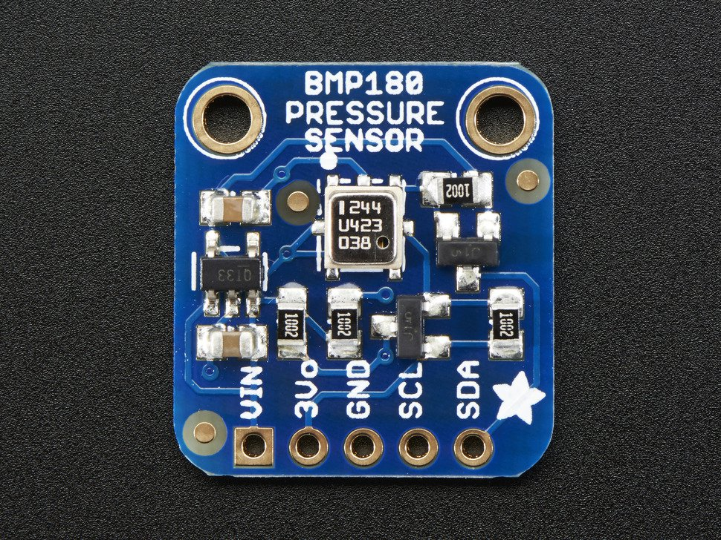
Barometer
BMP180
Measures:
Barometric Pressure
Altitude
Price: $9.95
Pros:
Works at altitudes (-500m to 9000m)
Cons
Sensitive to rapid temp change, moisture, and excess light

Slide 5
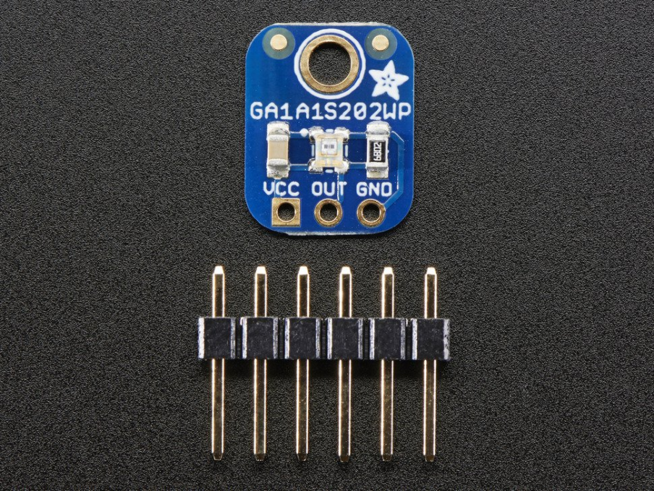
Light Sensor
GA1A12S202
Measures:
Light Level
Price: $3.95
Pros:
Approximates Human eye response to light
Wide Temp range (-30-80°C)
Cons:
Limited Dynamic Range (0.1-40000 lux)
Limited voltage Range (2.7-3.6V)

Slide 6
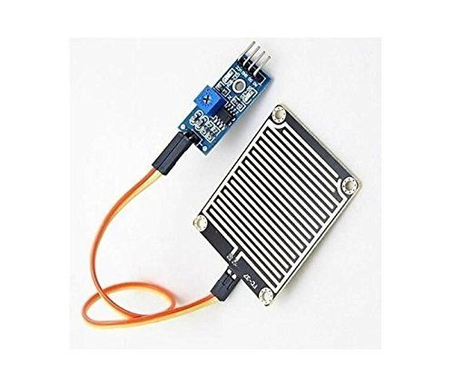
Precipitation Sensor
Arduino Precipitation
Measures:
Wetness of sensor
Detector
Price: $5.03
Pros:
Not custom made
Does the job
Cons:
Only measures how wet sensor is

Slide 7
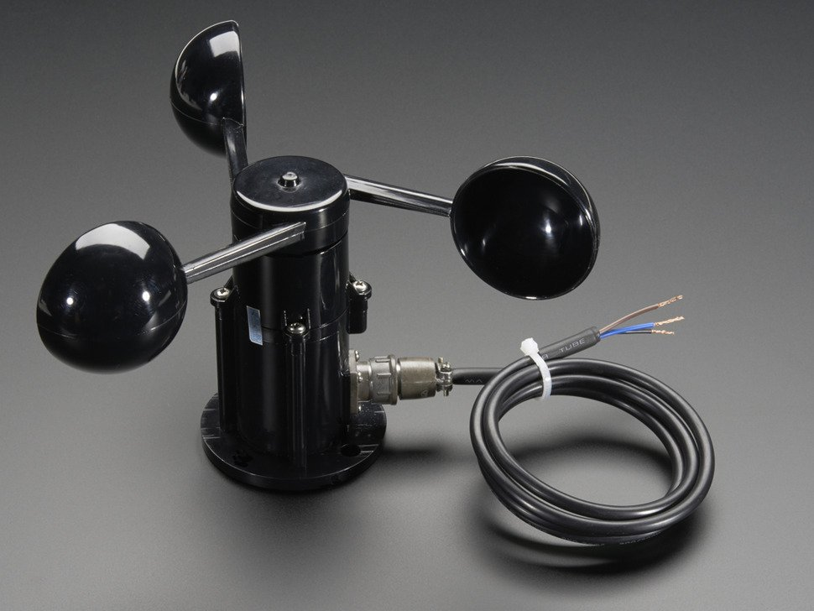
Anemometer
Anemometer (Adafruit)
Measures:
Wind Speed
Price: $44.95
Pros:
± 1 m/s Accuracy
Maxes out at 70 m/s
Good output voltage range
Cons:
Expensive

